Slide 1
The next strategic opportunity is here
Cloud
Mobile
Social
Big data
to architect business innovation?
IT
How do you use technology innovation…
?
Business
Increased
productivity
Customer growth
Real-time insights
Embrace new models
Notes:
Why this Slide:
You are trying to setup the struggle between IT and Business – you have to run a huge portfolio of apps, the business always wants more apps but you are struggling to just keep running what you have. In part this is also to cement that you are an expert and you understand their challenges.
Key Points:
Setup CHANGE is constant – you are being asked to do more with less
Business Pressure to innovate
IT Challenge of just operating IT takes most of the time/budget/resources
Transition to NEXT Slide: How will you put yourself in a position to rapidly deploy new tech to drive bus innovation?

Slide 2

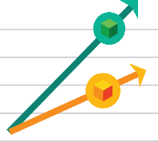

Business is powered by the cloud
“Cloud is a given. CIOs no longer ask whether they should use cloud, but rather how.”*
Improve efficiency
Enable innovation
Transform your business
“Traditional on-premises data storage is four times the cost of cloud storage.”**
“55% of CIOs indicated they would source all their critical apps in the cloud by 2020.”***
“Seventy percent of CIOs will embrace a cloud-first strategy by 2016.”****
Reduce
costs and inefficiencies
Increase revenue with existing assets
Create
new business models
*”Cloud Evolves From Point Solution To Strategic Enabler Of The New Connected Economy,” Forrester, Liz Herbert, January 2015
**Forrester, 2014
***Smith, David Mitchell et al. Predicts 2014: Cloud Computing Affects All Aspects of IT. Gartner, Inc. December 4, 2013.
****IDC, CIO webinar, 2014

Slide 3
Cloud & IT Strategy
Virtualization – there must be more..?
It’s cheaper – isn’t it..?
My DC is “constrained”..!
My Business Groups are using it..!
Public Cloud Platforms
PaaS
(Platform Services)
SaaS
(Software as a Service)
IaaS
(Infrastructure Services)
Can we STOP doing some things?
?
Your Datacenter Infrastructure
Virtual
Physical
Your Data Center
Notes:
Why this Slide:
You customer/audience is interested in Azure BUT they also have a data center to run today – you are trying to setup that you understand they have many challenges running their own data center and that they need help to do this that goes beyond virtualization – which was a good step. You also want to setup the Public Cloud and SaaS pillars because the combination of Private Cloud + Public Cloud + SaaS is THE Microsoft all up differentiator against ALL competitors.
Key Points:
You have a large DC investment – you have moved to a highly virtualized DC – but not getting all the benefits you expected
You are looking at Public Cloud – this is the moment to cover the Cloud Business Model – (1) You pay for what you use (2) You can change your mind
This business model changes OUR relationship – we have to make great stuff or you will stop using it AND we have to help you adopt and consume or our sales people don’t get paid – we are in this together…!
SaaS is MASSIVE – lot’s of opportunity to STOP running app infrastructure – O365 and SalesForce – multi-billion $ businesses – proven..!
Transition to NEXT Slide: So, how can Microsoft help..? What’s our strategy and how are we different to everyone else…?

Slide 4
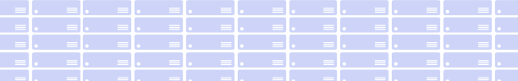
The Azure Platform Strategy
Public Cloud Platform
Platform Services
innovation
Platform
Services
Security & Management
Hybrid
Operations
Security & Management
Hybrid
Operations
SaaS
(Software as a Service)
O365, CRM, VSO etc…
+
3rd Party SaaS Solutions
Continuous
Improvement Delivers
Rapid Innovation
Everywhere…
Cloud-inspired infrastructure
Powered by Windows Server, Hyper-V, System Center, and Azure Technologies
Infrastructure Services
Compute
Storage
Network
Compute
Storage
Network
Azure Global Datacenters
Your Datacenter Infrastructure
Microsoft Azure
Public, Global, Shared Datacenters
Microsoft Azure Stack
& Cloud Platform System
Notes:
Why this Slide:
This is the Key Differentiator – no one else is going to help the customer in their own DC, has a world class public cloud which is also a SaaS platform and has killer SaaS apps as well – Customers want all this – we have it.
Key Points:
Start setting the stage for what is Azure – very high level – it’s IaaS AND PaaS on top of a global DC infra – but it’s just software
We can/will bring this software stack on-prem to help the customer with their own DC challenges
We have killer SaaS apps that help the customer stop doing things – like running email systems.
Our Platform is a platform for SaaS – if the customer is an ISV – benefits are building higher value SaaS service and/or keeping the “old” model of selling into the Customer DC…
Position the Competition – Old Guard on left (IBM, Oracle, HP), Cloud Platform Vendors (AWS, Google) on the right only, Salesforce in the middle (only) – MSFT does it all.
Transition to NEXT Slide: Summary – our strategy is 100% aligned to your strategy – but don’t just take my word for it, let’s see what some key influencers have to say…

Slide 5
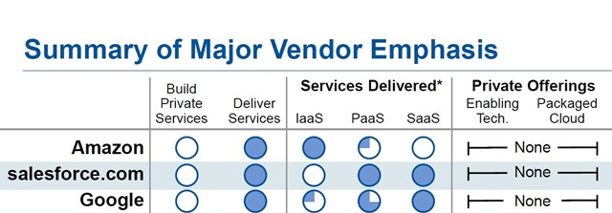
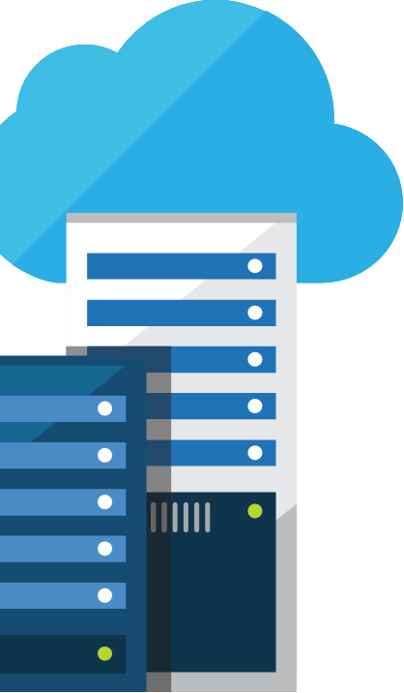
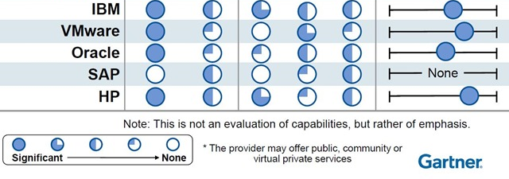
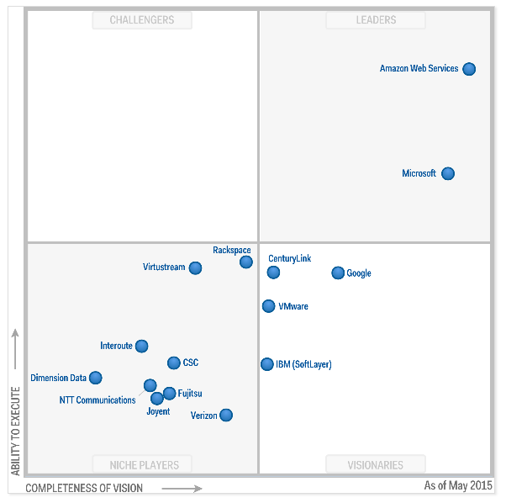
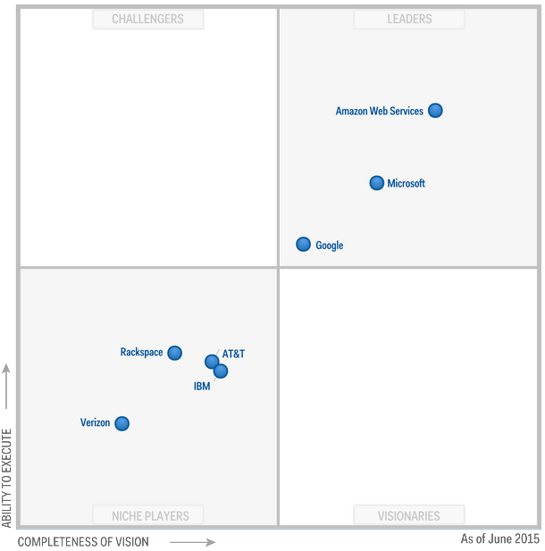
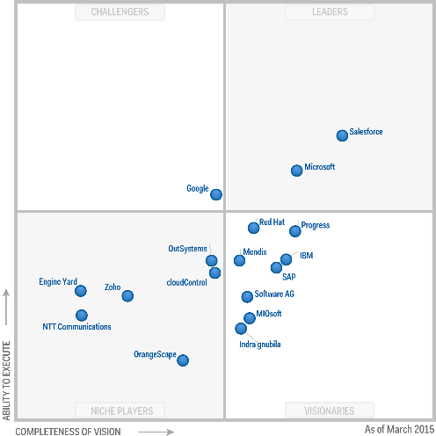
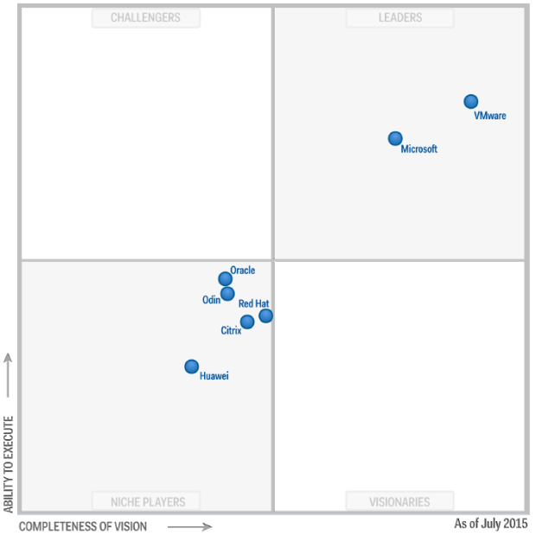
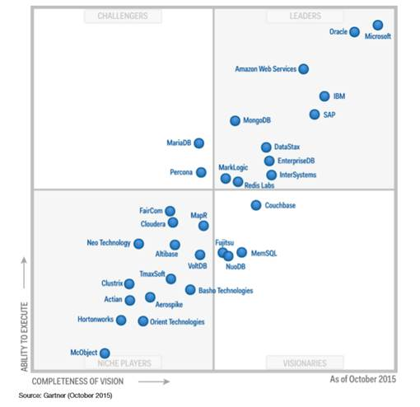
What about Microsoft..?
"Microsoft’s comprehensive hybrid story, which spans applications and platforms as well as infrastructure, is highly attractive to many companies, drawing them towards the cloud in general.”
LYDIA LEONG, Gartner
Microsoft leads in core technologies, IaaS, PaaS, Private and Public Clouds
Public Cloud IaaS (May 2015)
Cloud Storage (June 2015)
Enterprise App PaaS (Jan 2014)
X86 Server Virt (July 2015)
Operational DBMS Systems (Oct 2015)
Microsoft
Microsoft
Microsoft
Microsoft
Microsoft
*Gartner does not endorse any vendor, product or service depicted in its research publications, and does not advise technology users to select only those vendors with the highest ratings. Gartner research publications consist of the opinions of Gartner's research organization and should not be construed as statements of fact. Gartner disclaims all warranties, expressed or implied, with respect to this research, including any warranties of merchantability or fitness for a particular purpose.
Notes:
Why this Slide:
Extra weight to tell the story of our unique strategy – IMPORTANT – you are not selling a product or even a platform – you are really selling a long term vision – and you have to sell this high up.
Key Points:
Don’t go into any detail here, don’t get drawn into any specific MQ
MAIN POINT – MSFT continues to innovate – we are a true software and platform company and we have been doing this for 30 years (this is a dig at AWS mainly)
We are persistent – we strive but don’t always succeed to be the leader (be humble, but land that we have long term horizons, we will be there, we don’t back away from hard problems)
Transition to NEXT Slide: So let’s start understanding in more detail WHAT is Azure.

Slide 6
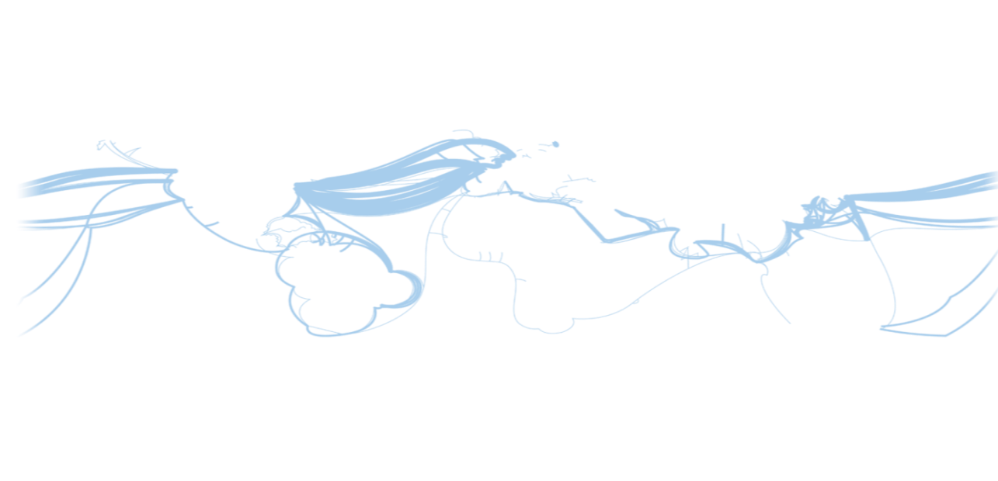
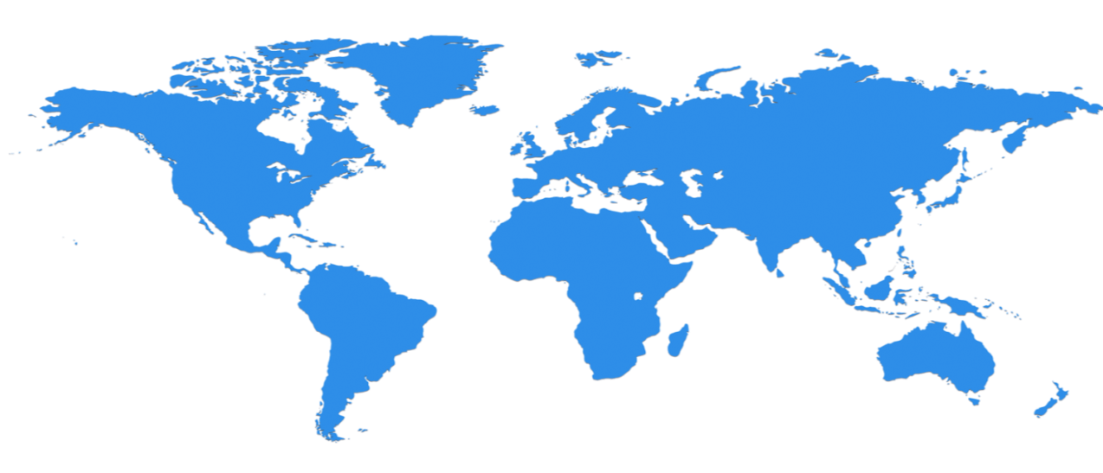

Hyper scale Infrastructure is the enabler
28 Regions Worldwide, 22 ONLINE…huge capacity around the world…growing every year
North Central US
Illinois
United Kingdom
Regions
West Europe
Netherlands
Canada Central
Toronto
United Kingdom
Regions
Central US
Iowa
Canada East
Quebec City
Germany North East **
Magdeburg
US Gov
Iowa
China North *
Beijing
North Europe
Ireland
Germany Central **
Frankfurt
China South *
Shanghai
Japan East
Tokyo, Saitama
West US
California
East US
Virginia
India Central
Pune
Japan West
Osaka
South Central US
Texas
East US 2
Virginia
US Gov
Virginia
India South
Chennai
India West
Mumbai
East Asia
Hong Kong
SE Asia
Singapore
Australia East
New South Wales
Brazil South
Sao Paulo State
Australia South East
Victoria
100+ datacenters
Top 3 networks in the world
2x AWS, 7x Google DC Regions
G Series – Largest VM in World, 32 cores, 448GB Ram, SSD…
Operational
Announced/Not Operational
* Operated by 21Vianet ** Data Stewardship by Deutsche Telekom
Notes:
Why this Slide:
This is SUCH a big investment – it’s a game for only very few. It’s not new for us – we have been doing this for our own services and our consumer/web properties for 20+ years
Key Points:
Where are we – EVERYWHERE…!
How big is this - $15+ B and counting – this is serious, we continue to bet big and you can count on us
Talk about DC innovation – DC Efficiency and Gen 5 data centers.
Scale – at this scale you do get efficiencies – the main one being POWER
Remember our “strategy” – we will be in the major places, but not everywhere – we have Azure Stack/Hosters for that.
Transition to NEXT Slide: This is the physical infrastructure that Azure sits on, now lets talk about Azure the PLATFORM

Slide 7
Azure StorSimple
Azure in Open
Azure Government
Azure SQL Database
Rights Management (RMS)
Azure API Management
Azure Site Recovery
Azure Automation
Instance Level Public Ips
Azure Redis Cache
Azure Batch
Azure Marketplace
Azure Data Factory
Stream Analytics
Event Hubs
Operational Insights
Premium Storage
Virtual Machine Converter 3.0
Cloud Platform System (CPS)
Antimalware for Cloud Services and VMs
Identity Manager vNext
Analytics Platform System (APS)
Visual Studio Community 2013
Visual studio 2015 Preview
.NET 2015
Azure RemoteApp
Azure AD Basic
SSD-based instances for Microsoft Azure VMs and Cloud Services
Azure SQL Database Auditing
Live Channels for Azure Media Services
AAD Application Proxy
New experiences in Power BI
Azure DocumentDB
Azure Search
HDInsight for Storm Public Preview & GA
Azure Zone Redundant Storage
HDInsight for Hbase
WSSC vNext tech preview
Content Protection pub preview
Intune - Nov update and Dec update
Azure AAD premium features
Multi-Factor Auth enhancements
Cloudera and Hortonworks on clustered Azure VMs
Azure Instance level IP
Azure Role Based Access Controls
VPN support pub preview
TiP Testing pub preview
Azure AD Workday A148 Integration
Azure Standard SSG
ExpressRoute S2S, P2S GA
Azure Multiple NICs
Azure Networking Appliances
Azure Traffic Manager Nested policies
Azure VM Image Gallery expansion
Azure Vnet
Azure Web Jobs
VSO datacenter expansion
VSO REST Hooks pub preview
Australia datacenter
Forced Tunneling
WSSC Azure Packs
Azure G-Serves Instances
Azure Key Vault
Drivers for SQL Server
MDM for Office 365 public preview and GA
Azure Media Services Content Protection
Azure Mobile Engagement
Node.js Tools for Visual Studio
Visual Studio 2013 updates
Auto-HA for SQL Server VM
Auto-Patching and Backup for SQL Server VMs
Azure SQL Database Increased Compatibility
Azure AD Connect Health pub preview
Azure AD MFA Per App / Conditional access pub preview
Azure RMS controlled user deployment
Azure RMS departmental templates pub preview
Azure Site Recovery SAN Replication
ASP.NET 5 Preview
Azure SDK 2.5.1
Team Foundation Server 2015 preview
Azure Machine Learning GA
Azure HDInsight for Linux Pub Preview
Azure HDInsight Support for Hadoop 2.6 pub preview
Azure SQL Database security feature - Data Masking pub preview
Azure SQL Database security features - Encryption
Azure SQL Database security features - Row Level security
Azure AD: API for SIEM
Microsoft Intune monthly updates
Remote Desktop Client for Windows Phone 8.1
Azure App Service
Azure CDN Integration
Azure Media Encoder Premium
Azure AD Premium & Basic in CSP
Azure IoT Suite
Windows Server Containers
Hyper-V Containers
Windows Server Nano Server
Azure Media Player GA
Azure Service Fabric
Azure IoT Suite
Azure Site Recovery: Protect VMWare and Physical Servers in Public Preview
Azure Backup Generally Available
Azure API Management Premium simplifies high availability and massive scale for APIs
ExpressRoute for Office 365
Azure Active Directory Dynamic Membership For Groups
Automatic Password Change for Social Media Shared Accounts
Compute-Intensive A10 and A11 Virtual Machine Instances
Remote Desktop app for Windows Phone support for Gateway and Remote Resources
Informatica Cloud Agent availability in Linux and Windows Virtual Machines
Azure DocumentDB Hadoop Connector
Azure HDInsight support for more VM sizes
Enterprise-Grade Array-Based Replication and Disaster Recovery with ASR and System Center GA
500+
New releases in
the last 12 months
Notes:
112

Slide 8














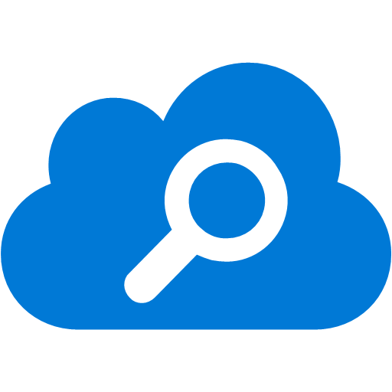


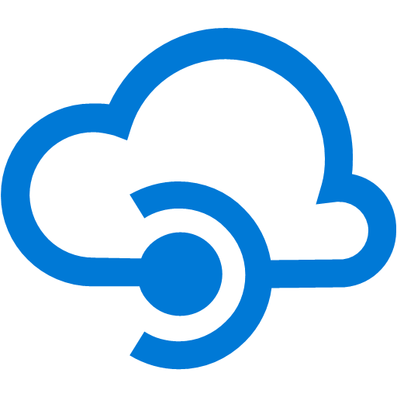


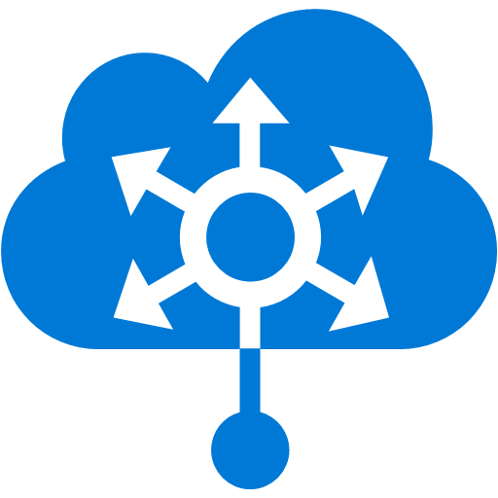
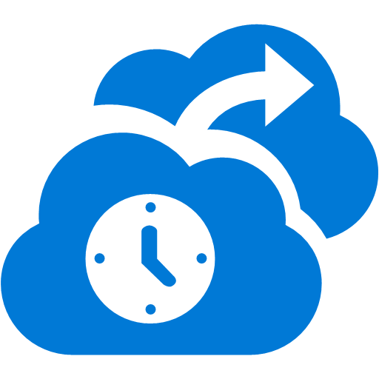






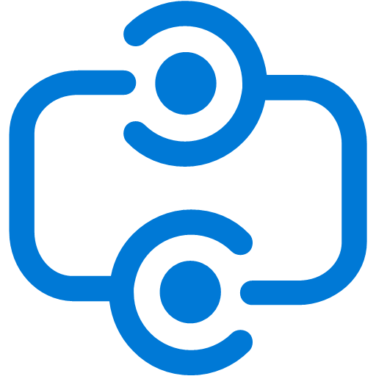


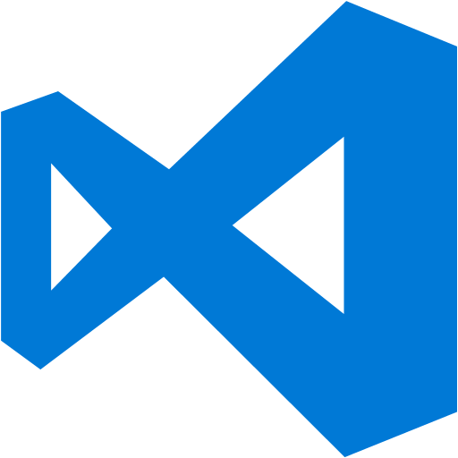


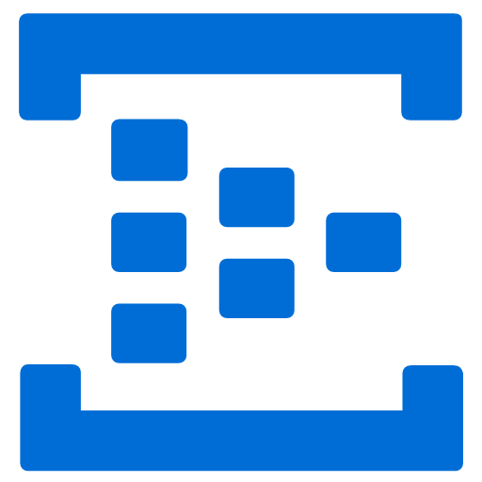



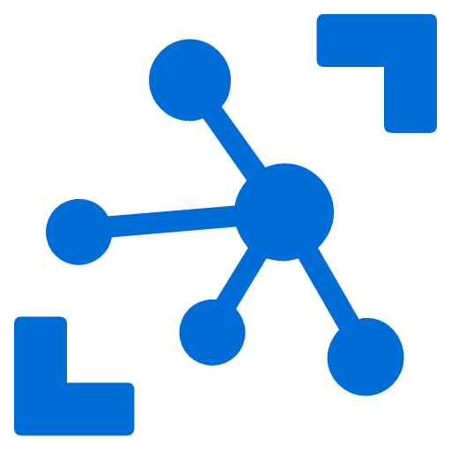
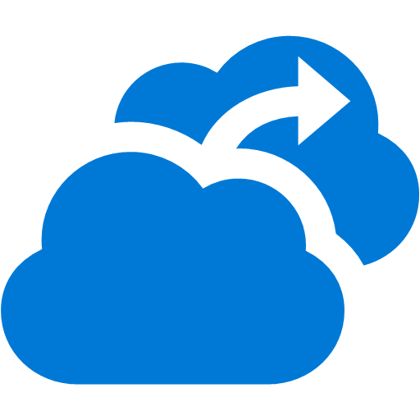
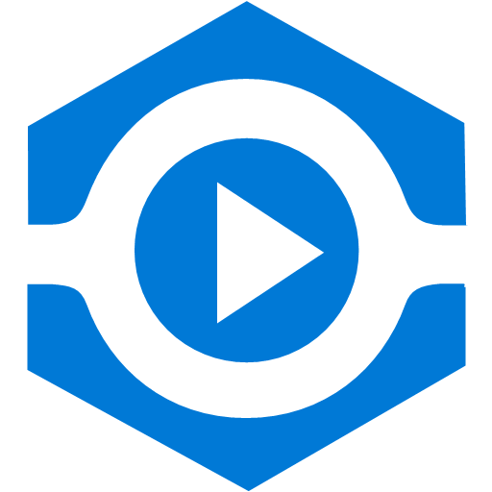







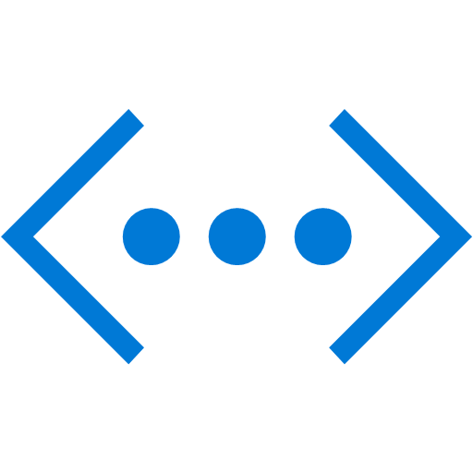


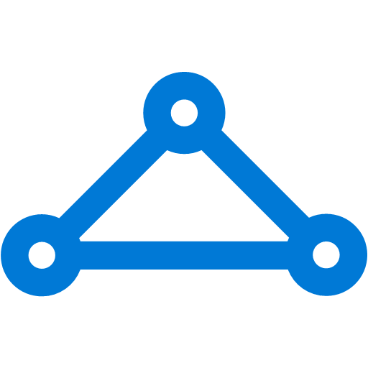


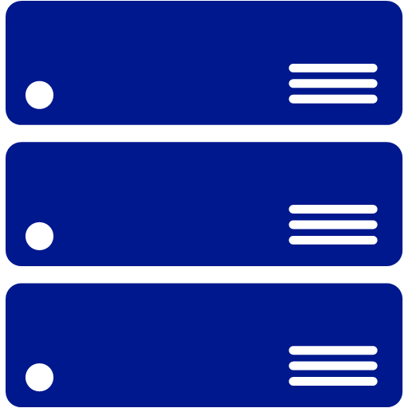
Platform Services
Security & Management
Services Compute
Web and Mobile
Data
Hybrid
Operations
Cloud
Services
Service
Fabric
Web Apps
API Apps
Portal
SQL
Database
Data
Warehouse
DocumentDB
Azure AD
Health Monitoring
Azure Active
Directory
Batch
RemoteApp
AD Privileged
Identity
Management
Mobile
Apps
Logic Apps
Redis
Cache
Azure
Search
Storage
Tables
Azure AD
B2C
Integration
Domain Services
Multi-Factor
Authentication
API
Management
Notification
Hubs
Storage
Queues
BizTalk
Services
Analytics & IoT
Backup
Automation
Hybrid
Connections
Service Bus
Developer Services
HDInsight
Machine
Learning
Stream
Analytics
Data
Lake
Operational
Analytics
Scheduler
Key Vault
Visual Studio
Azure
SDK
Data
Factory
Event
Hubs
Data
Catalog
Import/Export
Media & CDN
Store/
Marketplace
Media Services
Content Delivery
Network (CDN)
VS Online
App
Insights
Mobile
Engagement
Azure Site
Recovery
IoT Hub
VM Image Gallery
& VM Depot
StorSimple
Infrastructure Services
OS/Server Compute
Storage
Networking
Virtual Machines
Container
Service
BLOB Storage
Azure
Files
Premium
Storage
Virtual Network
Load Balancer
DNS
Express
Route
Traffic Manager
VPN Gateway
App
Gateway
Datacenter Infrastructure (28 Regions, 22 Online)
Notes:
Why this Slide:
It shows we have a very broad platform. It about BOTH IaaS and PaaS, that these work together. It shows that we continue to lead in world class IT capabilities and that there’s really nothing missing.
Key Points:
We have already seen how the Azure Platform is IaaS + Pass – but I want you to understand that this is a huge number of capabilities – IT building blocks if you will.
Every one of these blocks you provision anytime, self-service anywhere in the world 24x7. You pay for what you use, you can get more or less anytime and you can fully automate everything…
DON’T spent too much time on this slide – you are going to DEMO (aren’t you!!!)… DON’T go through each block…
Transition to NEXT Slide: Make the build go backwards to show JUST IaaS and then you will go to the demo to show it.

Slide 9
Demo: Azure IaaS
Notes:
Why this Demo:
Make it REAL and put teeth to what you talked about. Just logging into the portal and spinning something up across the other side of the world is VERY compelling – remember this is VERY VERY hard for most companies to do today and even if it was easy – the BUSINESS MODEL is different.
Key Points:
Spin up a new VM from the marketplace. Show IBM/Oracle/SQL in the marketplace. Show Linux section
Illustrate using the G5 in West US the business model and how the price (for a VM) is a combination of CPU/Ram + Features
After creating a VM, open up your existing VM you are already connected to. Use that VM to connect to your Linux VM – map these to the resources in the Portal.
Remember – YOU ARE RESPONSIBLE for everything that happens inside the VM – JUST like you are today in your own DC (plus you also have to look after everything that sits below the VM)…
Transition to NEXT Slide: Now let’s go back to the Azure Platform Picture – we need to talk about PaaS.

Slide 10
Platform Services
Security & Management
Services Compute
Web and Mobile
Data
Hybrid
Operations
Cloud
Services
Service
Fabric
Web Apps
API Apps
Portal
SQL
Database
Data
Warehouse
DocumentDB
Azure AD
Health Monitoring
Azure Active
Directory
Batch
RemoteApp
AD Privileged
Identity
Management
Mobile
Apps
Logic Apps
Redis
Cache
Azure
Search
Storage
Tables
Azure AD
B2C
Integration
Domain Services
Multi-Factor
Authentication
API
Management
Notification
Hubs
Storage
Queues
BizTalk
Services
Analytics & IoT
Backup
Automation
Hybrid
Connections
Service Bus
Developer Services
HDInsight
Machine
Learning
Stream
Analytics
Data
Lake
Operational
Analytics
Scheduler
Key Vault
Visual Studio
Azure
SDK
Data
Factory
Event
Hubs
Data
Catalog
Import/Export
Media & CDN
Store/
Marketplace
Media Services
Content Delivery
Network (CDN)
VS Online
App
Insights
Mobile
Engagement
Azure Site
Recovery
IoT Hub
VM Image Gallery
& VM Depot
StorSimple
Infrastructure Services
OS/Server Compute
Storage
Networking
Virtual Machines
Container
Service
BLOB Storage
Azure
Files
Premium
Storage
Virtual Network
Load Balancer
DNS
Express
Route
Traffic Manager
VPN Gateway
App
Gateway
Datacenter Infrastructure (24 Regions, 22 Online)
Notes:
Why this Slide:
You need some reference to come back to after the IaaS demo because now you are transitioning to PaaS. You want to focus the attention to the building blocks that you will show in the next demo – a web app, SQLDB, Storage and CDN.
Key Points:
We already said that your mental model of this picture is IT Lego – building blocks you provision and use. Your job is to work out what you need and to glue them together. Illustrate on the slide the 4 parts of the app you will use (Web + DB + BLOB Storage + CDN)
Reinforce PaaS – the SERVICE looks after everything for you. The responsibility to keep these services working is now Azure’s – NOT yours (as it is with software you run in a VM).
DON’T SPEND TOO MUCH TIME HERE – it’s a brief transition slide to the DEMO…
Transition to NEXT Slide: Let’s see PaaS in action

Slide 11
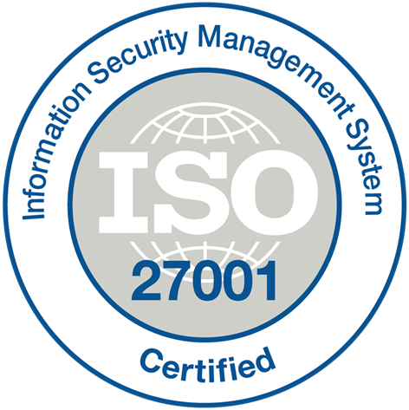
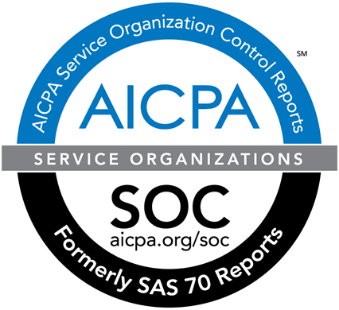
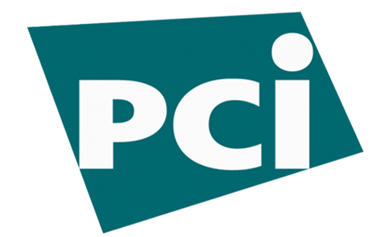
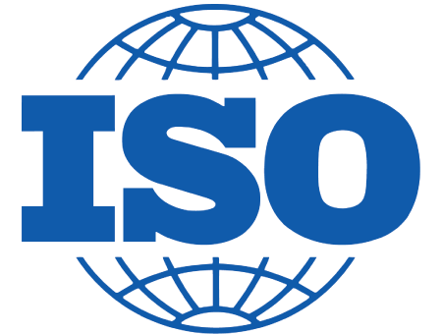


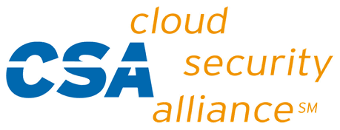





















Azure Compliance The largest compliance portfolio in the industry
ISO 27001
SOC 1 Type 2
SOC 2 Type 2
PCI DSS Level 1
Cloud Controls Matrix
ISO 27018
Content Delivery and Security Association
Shared
Assessments
FedRAMP JAB P-ATO
HIPAA / HITECH
FIPS 140-2
21 CFR
Part 11
FERPA
DISA Level 2
CJIS
IRS 1075
ITAR-ready
Section 508 VPAT
European Union
Model Clauses
EU Safe Harbor
United Kingdom
G-Cloud
China Multi
Layer Protection Scheme
China
GB 18030
China
CCCPPF
Singapore
MTCS Level 3
Australian Signals
Directorate
New
Zealand
GCIO
Japan
Financial Services
ENISA
IAF
Notes:
Why this Slide:
Now you have finished the what is Azure section you want to do a few things – you want them to explain the trust model and give them some comfort they are not the first here – it’s a safe bet.
Key Points:
Azure Compliance makes it easier for first parties and end customers to fulfill their own compliance obligations across globally regulatory and industry standards.
Explain the FUNDAMENTAL TRUST model. These organizations (above) we let into our data centers and they attest that we do all the things on their list of controls. You (the customer) have to trust these organizations.
You still OWN much of the work to make your systems compliant – we have the platform and the capabilities – but you have to decide to use them (example you have to decide to encrypt virtual disks for your VM’s – or NOT).
Transition to NEXT Slide: Are you the first to do this… Of course not…

Slide 12
Azure Momentum
100,000
New Azure customer subscriptions/month
20 Million
SQL database hours used every day
>50 Trillion
Storage objects in Azure
“Microsoft is growing its cloud revenue faster than Amazon” – Business Insider 2016
AWS revenue grew about 69% but Microsoft Azure revenue grew by 127%
425 Million
Azure Active Directory Users
60 Billion
Hits to Websites run on Azure Web App Service
57%
Of Fortune 500 Companies use Microsoft Azure
>5 Trillion
Storage transactions every month
1 Trillion
Messages delivered every month with Event Hubs
1.4 Million
SQL Databases Deployed
In Azure
Notes:
Why this Slide:
It is important to give some sense of the scale of the cloud, the rapid pace of adoption and how MSFT is doing
Key Points:
The cloud is still quite new and already we are talking about billions and trillions of things –imagine what this will look like 5 years from now
Adoption of Azure is off the chart by any scale – 100,000+ new customers come to Azure every month and this pace is increasing
Transition to NEXT Slide: So we have lots of customers, growth is crazy – but isn’t Azure just for Microsoft shops – NO!!!.

Slide 13

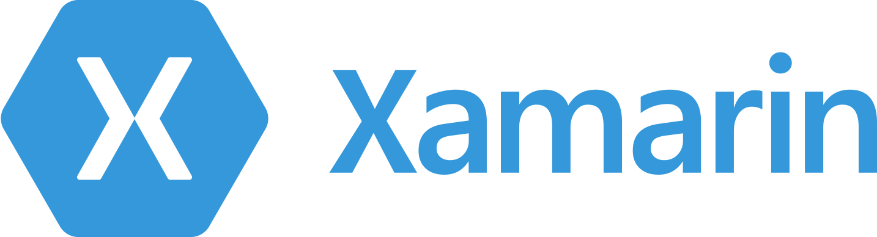
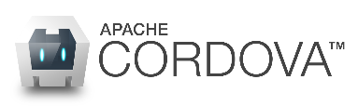
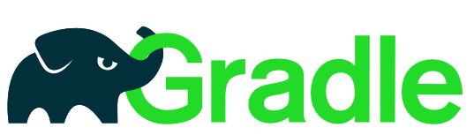

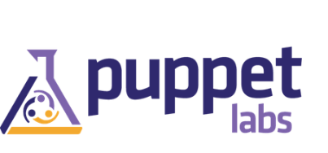

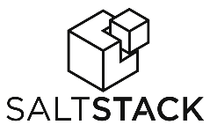




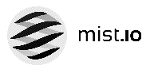




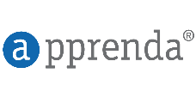
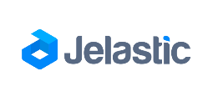
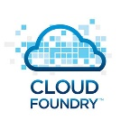
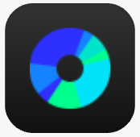



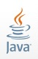








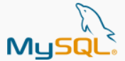

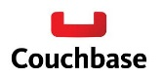






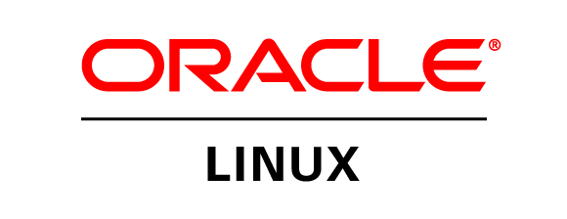
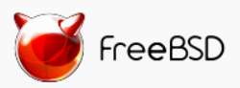

Azure is an open cloud
DevOps
Clients
Management
Applications
PaaS &
DevOps
App Frameworks
& Tools
Databases &
Middleware
Infrastructure
Notes:
P2

Slide 14
Getting started with Azure
Your IT Portfolio ($$, Resources, Effort)
Non-Production
Production
1. Application Operations
You have A LOT of this… 50-70% or more ???
It’s used 5-10% of the time
Projects here are Low Risk, can have big ROI
25% Existing Custom apps
2. Apps you Bought
What can you STOP doing… use the SaaS model
Microsoft (O365/Exchange/SharePoint, CRM, Visual Studio Online etc.)
50% App Operations
10% New business apps
3. Apps you would LIKE to build
15% Packaged apps
Use the Azure PaaS building blocks
More Productive, Less Infrastructure Work
4. Existing Production Apps you Built
Leave 80% of existing custom apps alone
MOVE SMALL and high burst workloads
Notes:
Why this Slide:
You are getting to the end of your presentation and you need to help the customer understand WHERE to start, what to do first and what to leave until later… You want to get a specific action, a project, a POC… this will help start that dialog…
Key Points:
Help the customer realize that the majority of what they have today is NOT PRODUCTION and NOT MISSION CRITICAL. Get them off their worst possible case and get them off issues around compliance and regulation (which tend to apply to production/mission critical apps).
Non-Production (Dev Test, Backup, DR) – these are the workloads to do first
DO NOT MIGRATE EXISTING PRODUCTION APPS (a few exceptions).
Transition to NEXT Slide: The next 4/5 slides are just details behind these concepts and we illustrate “some” of the Azure building blocks that are key to these slices of the pie chart.

Slide 16

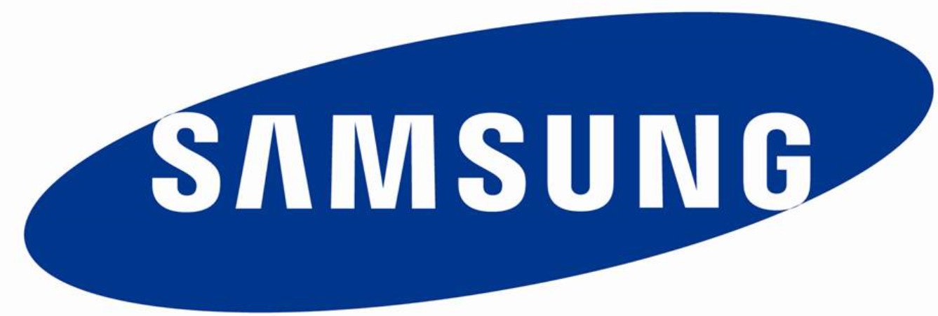



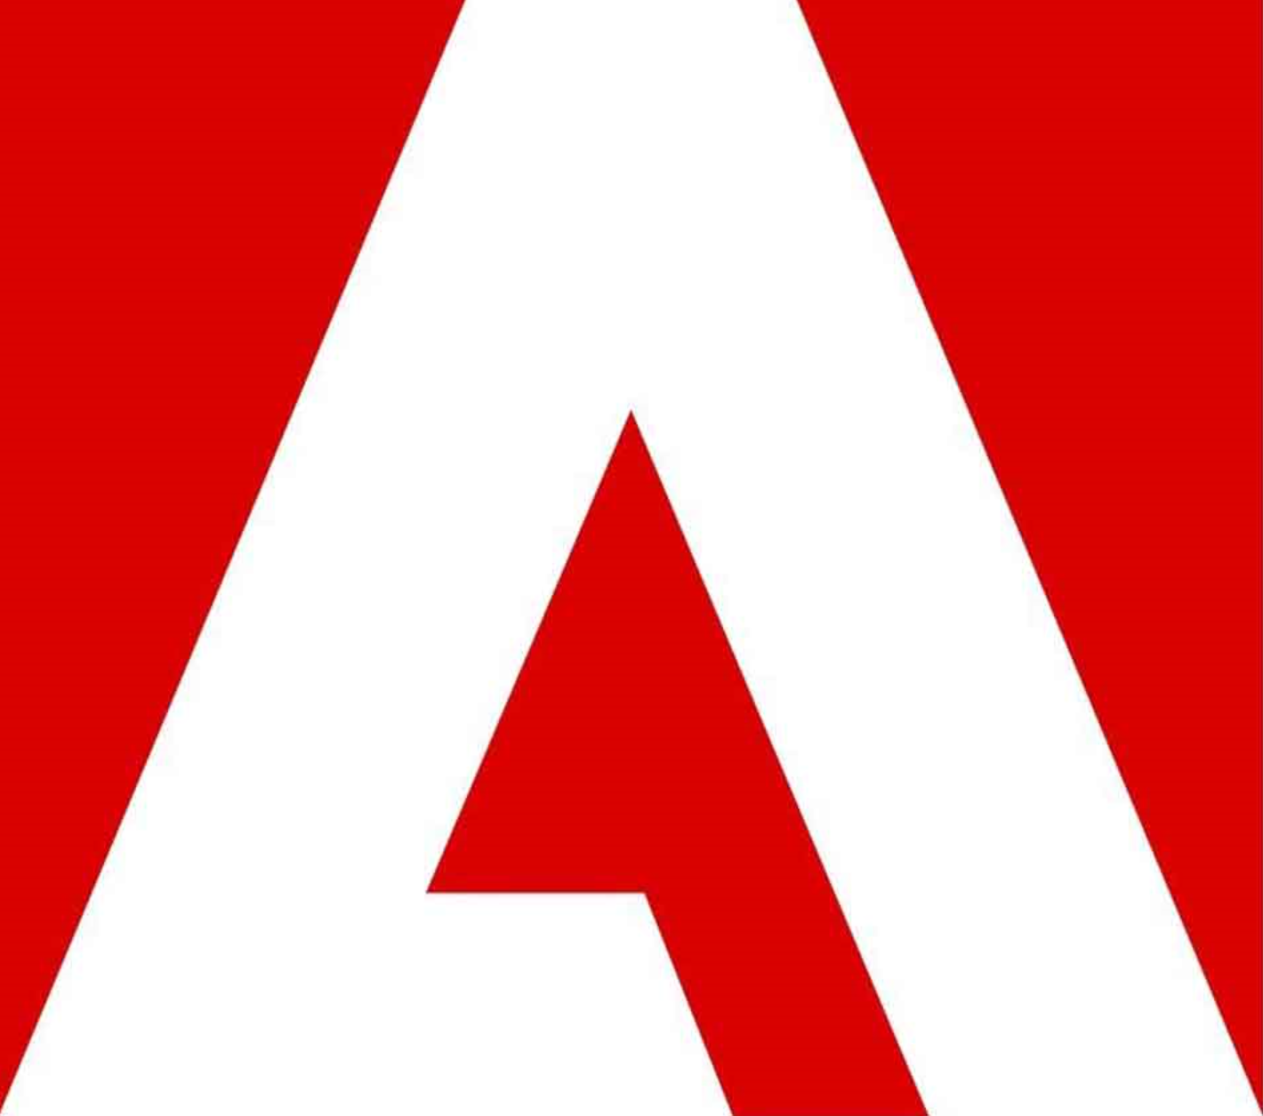

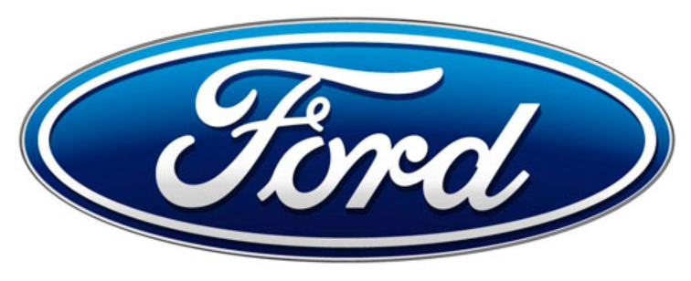
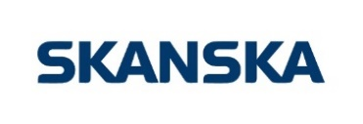






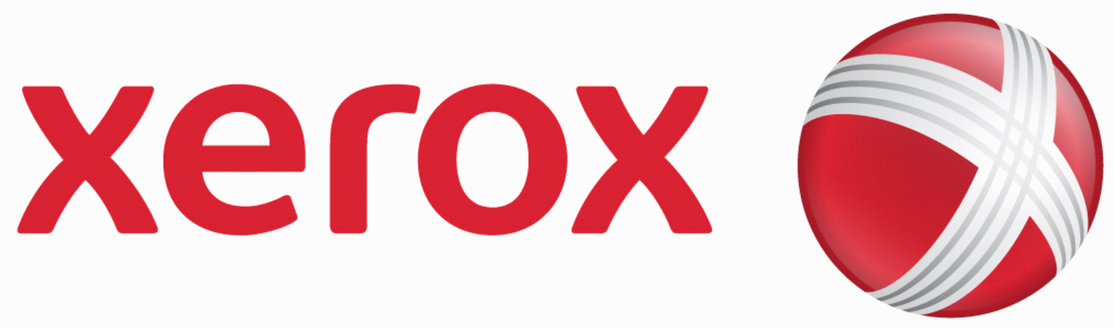

Ford
Notes:
Why this Slide:
Custom evidence is sometimes useful, but mainly if it’s very specific. See the evidence slide in the appendix for how to get specific evidence.
Key Points:
There are just lots and lots of customers using this doing all sort of things both on the operational efficiency side as well as on the innovation side.
Transition to NEXT Slide: Some data points that might help you size up the sort of massive adoption and momentum.

Slide 17






























App Operations
YOUR
DATA CENTER
Gallery
Your Image
Library
AZURE VIRTUAL MACHINES
Windows
App 1
VIRTUAL
NETWORK
Linux
App 2
NON-PRODUCTION
VIRTUALIZED
APP ENVIRONMENTS
SQL
25% Custom apps
…
50% App operations
STORAGE BLOBS / FILES (Virtual Disks)
10% New business apps
Visual Studio Online
15% Packaged apps
WAYS TO CONNECT YOUR DATA CENTER TO AZURE
Express Route Partners

Slide 18




Business Continuity & Disaster Recovery
Orchestrated Hyper-V VM Replication & Recovery into Microsoft Azure with Azure Site Recovery
Microsoft Azure Backup
1
2
StorSimple Appliance iSCSI Disk shuffles/de-dups/encrypts stale data to Azure
SQLServer HA/AlwaysOn Replication to Azure and Database Backup
3
}
Centralized backup with Data Protection Manager
SQL
SQL
Hyper-V Guest Clustering for app- level HA, i.e. SQL Server AlwaysOn FCI
4
Orchestrated VM Replication & Recovery using Azure Site Recovery (Including VMware & Physical)
Hyper-V Failover Clustering for VM Resilience
Simplified protection with Windows Server Backup

Slide 19

Packaged Apps
Simple connection
Self-service
Single sign on
25% Custom apps
Username
•••••••••••
50% App operations
10% New business apps
15% Packaged apps
Microsoft Azure Active Directory
Windows Server
Active Directory
Other Directories
SaaS
Azure
Public
cloud
Office 365
Cloud
Your Data Center

Slide 20

New Business Applications
25% Custom apps
50% App operations
10% New business apps
15% Packaged apps
Move up the stack – to PaaS – as much a cultural shift as a technology shift
Azure handles resilience, servicing, management
Shift to Optimization from deployment/ops

Slide 21

Custom apps
In General – LEAVE THESE ALONE (for now)
Exceptions:
High Burst/HPC – Expensive, Capacity Constrained Easily Virtualized Apps… HPC Pack, Azure Batch, HPC Hardware
Low Usage Apps – move and optimize cost
EOL Hardware – Reduce DC footprint -> Azure Virtual Machines
25% Custom apps
50% App operations
10% New business apps
15% Packaged apps
Cloud-enable apps
Run the applications you use on workstations and clusters today
Run at scale
Batch takes care of starting a pool of compute VMs for you when you’re ready to run a job
Manage delivery
Manage who can access it, how many resources they can use, and ensure requirements such as encryption are met

Slide 22
We want you to be at the center of application innovation
Why is the business using shadow IT?
Why is my CIO looking at agile alternatives?
INNOVATION
VALUE TO BUSINESS
APPLICATIONS AND SERVICES
Why is investment in apps growing so much faster than IT?
EFFICIENCY
INFRASTRUCTURE
EVOLUTION OF DATACENTER
Notes:
Objective:
Establish that the cost reduction benefits that have come from virtualization are coming to an end and IT organizations need look to new innovations associated with operating services in a cloud model in order to realize the next wave of business value.
Key talking points:
Virtualization has been amazing technology for the datacenter, enabling efficiencies and cost savings through increased density and decoupling workloads from physical server hardware. But 10 years later we’re starting to run out of workloads to virtualize leaving businesses wondering where IT should look for the next wave of business value.
For the answer, IT needs to look to where the business is investing. Research shows more business departments spending on so-called “shadow IT”; public clouds offering IaaS and higher level services through a consumer-style self service provisioning portal that delivers IT resources more rapidly and easily than using the internal IT department. Some organizations already recognize this threat and have chosen to create a new, more agile IT alternative within the organization. Looking higher up the stack, businesses are growing their investment in applications at a much faster rate compared with infrastructure investment.
IT organizations need to get back into the game by looking to new innovations that support applications and services that drive the business forward. <click> The good news is that Microsoft has been delivering applications and services in this model in Microsoft Azure for several years and has developed a series of innovations from that experience.
Let’s take a look at Azure today.
Before virtualization IT was considered a cost center thus TCO was the most important attribute for Businesses
Virtualization helped IT reduce TCO by consolidation and better utilization of Infrastructure thereby adding value to the business
Most of the enterprises have optimized their infrastructure using Virtualization - 70% of all x86 architecture workloads are virtualized *. There is not a lot of scope left for IT to add value through virtualization alone
Businesses now want to use this virtualized Infrastructure to power their innovation agenda and TCO, although still important, is second to innovation for Businesses. This has opened a door for IT to provide enormous value to the Business and become part of this innovation agenda
This innovation is happening through applications and infrastructure optimization alone is insufficient to power this innovation
Businesses are starting to recognize this. Spending on Enterprise software and applications is projected to increase by 7.2% CAGR in next 4 years as compared to 4.4% in overall IT spending -- that means software and application spending is projected to grow nearly twice as fast as overall IT spending
Datacenters lack the ability to support applications based innovation
38% of IT spending is happening outside IT ***. This is projected to grow beyond 50% by 2017 ***
“45% of CIOs have a second, fast, mode of service delivery that complements their rock solid operations”….from Gartner Symposium, Oct 2014
“38% of IT spend is outside IT and growing. Salespeople are going directly to the business - whether you like it or not”….from Gartner Symposium, Oct 2014

Slide 23









Network Coverage
Express Route Partners
Plus 31 CDN Point of Presence locations
AZURE REGIONS
EXPRESSROUTE LOCATIONS
CDN POINT OF PRESENCE
Notes:
Source: http://azure.microsoft.com/en-us/documentation/articles/expressroute-locations/#network-service-provider-nsp-locations
CDN Source: https://msdn.microsoft.com/en-us/library/azure/gg680302.aspx
AT&T
British Telecom
Colt
Internet Initiative Japan Inc.
Level3
Orange
SingTel
Tata Communications
Telstra Corporation
Verizon
Aryaka
Colt
Equinix
InterCloud
Level3
TeleCityGroup
Zayo

Slide 24
Cloud OS Network
>100 Countries
>600 Local datacenters
>100 World-class partners
>3.7M Customers every day
AZURE REGIONS
EXPRESSROUTE LOCATIONS
CDN POINT OF PRESENCE
CLOUD OS NETWORK PARTNERS
Notes:
Source: http://www.microsoft.com/en-us/server-cloud/cloud-os-network.aspx

Slide 25
The Microsoft Platform Strategy
Software As a Service
Office 365, CRM, AX, VS Online, etc
Global SaaS Market
Platform Services
Platform
Services
Security & Management
Hybrid
Operations
innovation
Security & Management
Hybrid
Operations
Cloud-inspired infrastructure
Powered by Windows Server, Hyper-V, System Center, and Azure Technologies
Infrastructure Services
Engineering Driven
IaaS AND PaaS Platform
Hybrid Software
Compute
Storage
Network
Compute
Storage
Network
Azure Global Datacenters
Your Datacenter Infrastructure
Microsoft Azure
Public, Global, Shared Datacenters
Microsoft Azure Stack
& Cloud Platform System
Notes:
Why this Slide:
This is the Key Differentiator – no one else is going to help the customer in their own DC, has a world class public cloud which is also a SaaS platform and has killer SaaS apps as well – Customers want all this – we have it.
Key Points:
Start setting the stage for what is Azure – very high level – it’s IaaS AND PaaS on top of a global DC infra – but it’s just software
We can/will bring this software stack on-prem to help the customer with their own DC challenges
We have killer SaaS apps that help the customer stop doing things – like running email systems.
Our Platform is a platform for SaaS – if the customer is an ISV – benefits are building higher value SaaS service and/or keeping the “old” model of selling into the Customer DC…
Position the Competition – Old Guard on left (IBM, Oracle, HP), Cloud Platform Vendors (AWS, Google) on the right only, Salesforce in the middle (only) – MSFT does it all.
Transition to NEXT Slide: Summary – our strategy is 100% aligned to your strategy – but don’t just take my word for it, let’s see what some key influencers have to say…

Slide 26
The Amazon Platform Strategy
Platform
Services
PUBLIC CLOUD ONLY
Security & Management
Operations
Infrastructure Services
Customer Need Driven
Innovate using OSS
IaaS Centric Platform
Compute
Storage
Network
Global Datacenters
Your Datacenter Infrastructure
Amazon Web Services
Public, Global, Shared Datacenters
Notes:
Why this Slide:
This is the Key Differentiator – no one else is going to help the customer in their own DC, has a world class public cloud which is also a SaaS platform and has killer SaaS apps as well – Customers want all this – we have it.
Key Points:
Start setting the stage for what is Azure – very high level – it’s IaaS AND PaaS on top of a global DC infra – but it’s just software
We can/will bring this software stack on-prem to help the customer with their own DC challenges
We have killer SaaS apps that help the customer stop doing things – like running email systems.
Our Platform is a platform for SaaS – if the customer is an ISV – benefits are building higher value SaaS service and/or keeping the “old” model of selling into the Customer DC…
Position the Competition – Old Guard on left (IBM, Oracle, HP), Cloud Platform Vendors (AWS, Google) on the right only, Salesforce in the middle (only) – MSFT does it all.
Transition to NEXT Slide: Summary – our strategy is 100% aligned to your strategy – but don’t just take my word for it, let’s see what some key influencers have to say…

Slide 27


Azure and AWS Regions
Azure (28 regions, 22 online)
AWS (16 regions, 12 online)
Disaster proof Region Pairs in a geo-political area
No geo-political region pairs, regions are not disaster proof
A region is a massive mainly purpose built Data Center (DC)
A region is a collection of smaller owned and colo DC’s called Availability Zones (AZ’s) – 32 in total
DC’s have multiple layers of hardware and software redundancy for HA
AZ’s are well connected across flood plains and within a short car journey for HA
Region to Region traffic over Azure backbone
Region to Region traffic over public internet
You CAN visit an Azure DC..!
You CANNOT visit an AWS DC..?

Slide 28

Trusted Cloud principles Key Differences compared to AWS
Security
Microsoft creates and implements industry-leading secure software development, operational management, and threat mitigation practices. This includes Trustworthy computing initiative, security center of excellence, compliance framework.
Microsoft is the only company actively targeting cyber criminals and working with law enforcement to take down their ability to infect devices and systems with harmful, criminal malware.
Azure Security center is truly a differentiated offering
Compliance
Azure adhere to a broad set of compliance requirements and provide tools to help our customers meet their cloud security & compliance requirements.
We commit to yearly audit and provide full audit report
Azure offers Financial Services Compliance Program built for large financial institutes.
Privacy
Azure offers cloud specific privacy policy.
Microsoft does not use customer data for advertising
Microsoft makes contractual commitment to safeguard customer data and privacy.
Microsoft cannot change its core privacy terms during the course of a customer’s subscription.
Azure complies with rigorous EU privacy laws. Azure is the first major cloud provider to adopt ISO 27018 – world’s first international standard for cloud privacy.
Transparency
We publish details in the Microsoft Law Enforcement Requests Report about legal demands for customer data.
Microsoft makes a contractual commitment to ensure any requests for data must follow due legal process.
Customer owns their data, they can delete and leave anytime.
Microsoft Customer Agreement does not contain any IP infringement protection language

Slide 29
Enterprises want a vendor they can trust …
Your Privacy Matter
Leadership in Transparency
Independently verified
Relentless on Security
Service Continuity
Privacy policy specific to Azure.
ISO 27018 privacy standards
No Data is used for Advertisement
Contractual commitments
Law enforcement request
You know ‘where’ data resides, ‘who’ can access it and ‘what’ we do with it
DC Transparency
Compliance with World Class Industry standards verified by 3rd parties
Excellence in cutting edge security practices
Encryption at Rest across various services
Network Security Groups, Key Vault
Financially backed SLAs across all GA Services
Azure
Amazon.com Privacy policy
Data can be used for Advertisement
Limited contractual commitment
Ask customers to absorb cost for Law enforcement requests notificatoons
You know ‘where’ data resides, ‘who’ can access it and ‘what’ we do with it
Don’t disclose DCs architecture details
Compliance with World Class Industry standards verified by 3rd parties
Excellence in cutting edge security practices
Encryption at Rest & HSM
Firewalls/Network ACLs
SLA is only available with EC2, EBS ,S3,CloudFront & RDS
AWS
Notes:
http://searchaws.techtarget.com/news/4500248191/Amazon-transparency-report-fails-to-quell-AWS-concerns

Slide 30
Enterprise Data Centers are here to stay Microsoft is helping improve them and connect them to the Cloud…
HYBRID
STORAGE
StorSimple + Azure Storage
HYBRID
BACKUP + DR
Azure Backup + Azure Site Recovery
HYBRID
DATABASE
SQL Server 2016 StretchDB + Azure SQL DB
HYBRID
CONSISTENCY
Azure Stack + Cloud Platform System
HYBRID
IDENTITY
Azure Active Directory
HYBRID
CLOUD MANAGEMENT
Operations Management Suite + System Center
HYBRID
APP INTEGRATION
Azure ServiceBus + BizTalk Services
HYBRID
CONNECTIVITY
VPN + ExpressRoute

Slide 31
Summary
Strategy
Infrastructure
Platforms
Trust
Privacy Focus
Many SLA’s
Security
Compliance
Transparent
Private Cloud
Public Cloud (IaaS AND PaaS)
Software as a Service
Hyper Scale
28 Azure Regions
100+ Data Centers
Inter Region Network
DC Innovation
IaaS Leader
PaaS Leader
Private Cloud
Hybrid Approach
Azure
Private Cloud
Public Cloud (IaaS AND PaaS)
Software as a Service
Cloud Scale
16 Regions
32 AZ’s/Data Centers
Inter Region Network
Traditional DC/Colo
IaaS Leader
PaaS Leader
Private Cloud
Hybrid Approach
Privacy Focus
Many SLA’s
Security
Compliance
Transparent
AWS

Slide 32

Getting Evidence
The best place for evidence:
https://microsoft.sharepoint.com/teams/cloudosevidence/Pages/evidence-generator.aspx

